Slide 1
Big Mountain resort
Tasmia Kayenat

Slide 2
Problem Identification
Big Mountain resort in Montana is dealing with a capitalization issue where they cannot determine whether to increase the ticket prices based on the facilities they have or cut the budgets.

Slide 3
PROBLEM
Capitalization
Less than potential outcome due to the lack of business intelligence.
Ticket Prices
Not helping capitalizing, in fact, the price is less compared to the facilities they have.
Facilities
Need to be compared with other resorts to figure out the potential ticket prices.
COSTS
Need to review the costs to cut budget if necessary.

Slide 4
Recommendation & Key findings
Missing Values
Large Areas
There were some missing values in the columns that has been sorted out.
The resort's state of Montana was in the top five for size.`
Cost
Increase Ticket Price
Reduce the operation cost by permanently closing the 10 least used runs.
Part of the goal for this project is to increase the ticket price for better capitalization.

Slide 5
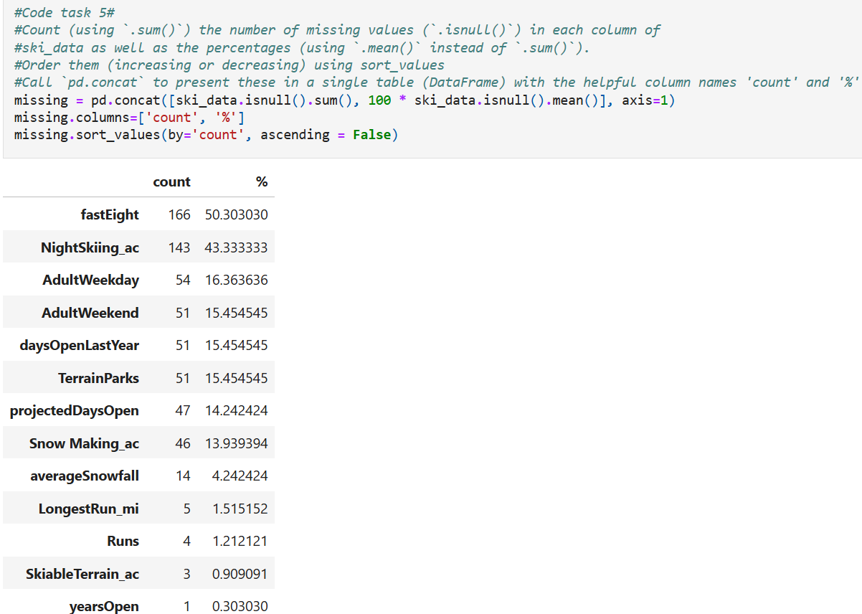
Modeling results and analysis
MISSING VALUES

Slide 6
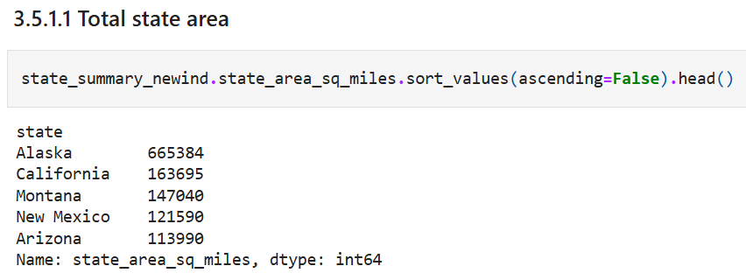
Large areas
Using the sort_values() on the state_area_sq_miles we figured that Montana comes in third in size.

Slide 7
COST
Some potential scenarios for cutting cost or increasing revenues include:
1. Permanently closing down up to 10 of the least used runs. This doesn't impact any other resort statistics.
2. Increase the vertical drop by adding a run to a point 150 feet lower down but requiring the installation of an additional chair lift to bring skiers back up, without additional snow making coverage
3. Same as number 2, but adding 2 acres of snow making cover.
4. Increase the longest run by 0.2 mile to boast 3.5 miles length, requiring an additional snow making coverage of 4 acres

Slide 8
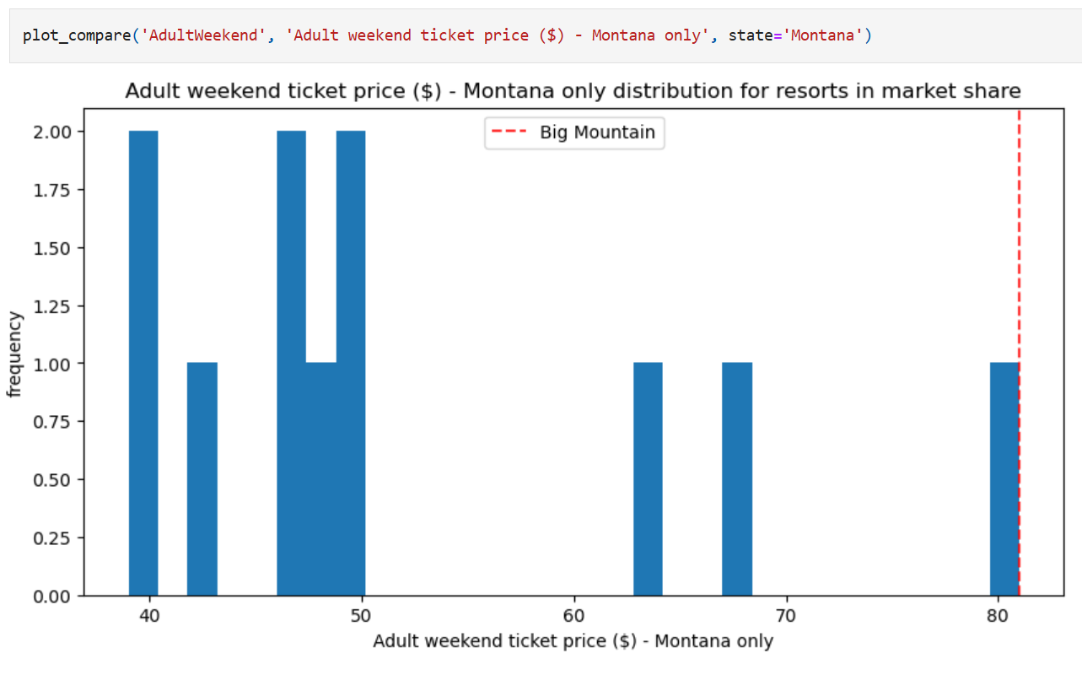
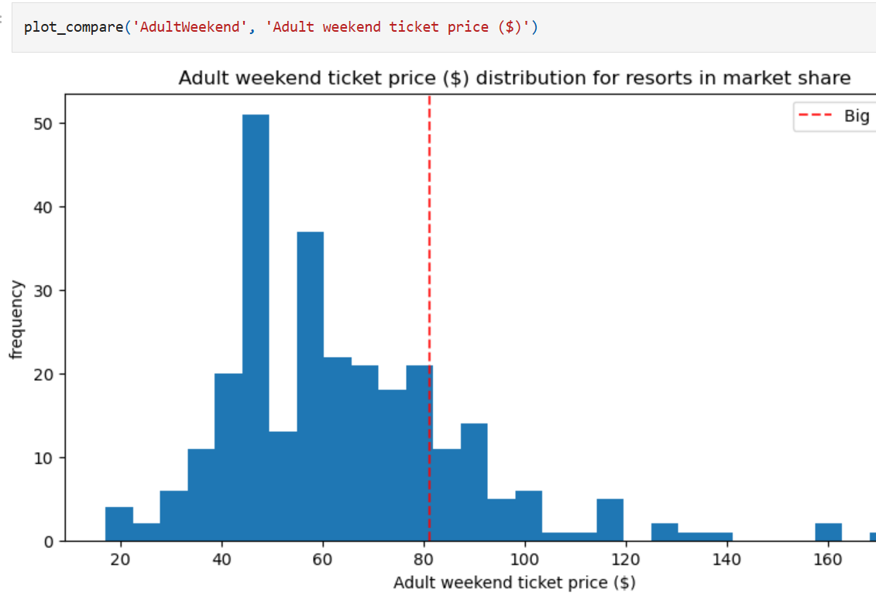
Ticket prices
Montana resorts during weekend:
Resorts in market share during weekend:

Slide 9
Summary & conclusion

Slide 10
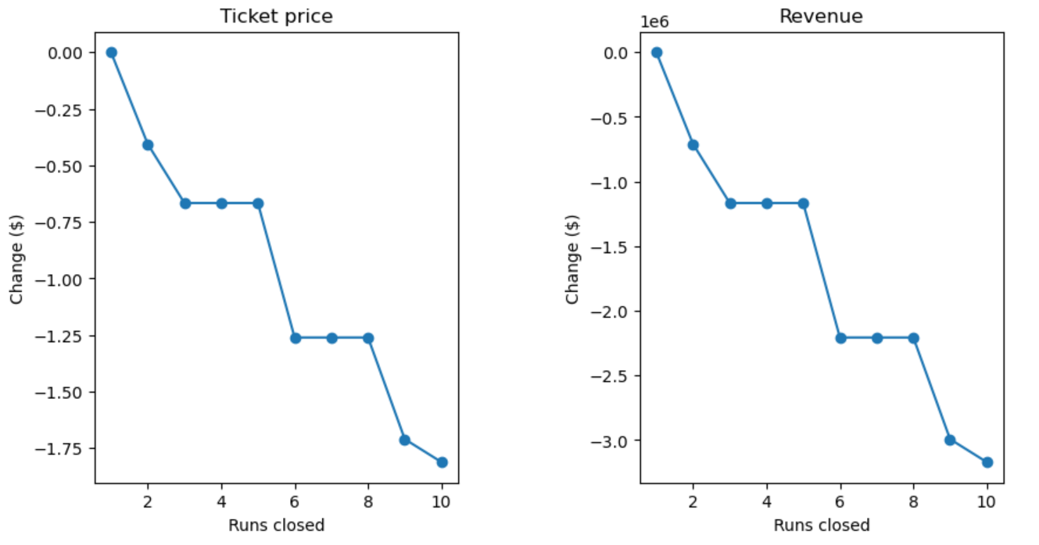
Scenario 1:
Close up to 10 of the least used runs. The number of runs is the only parameter varying.
The model says closing one run makes no difference. Closing 2 and 3 successively reduces support for ticket price and so revenue. If Big Mountain closes down 3 runs, it seems they may as well close down 4 or 5 as there's no further loss in ticket price. Increasing the closures down to 6 or more leads to a large drop.

Slide 11
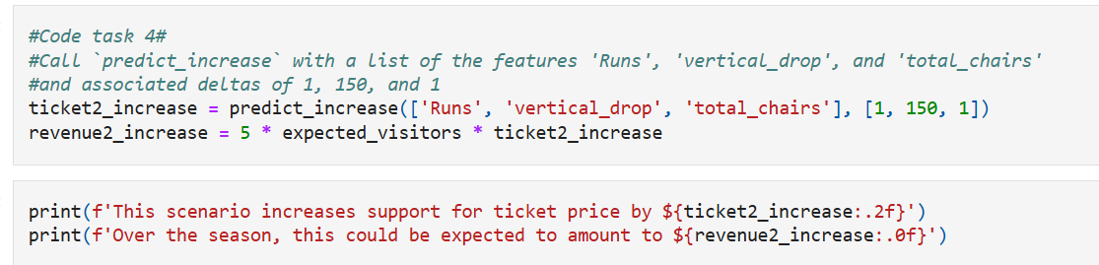
Scenario 2:
This scenario increases the support for ticket price by $8.61.
Over the season this could be expected to amount to $15065471.

Slide 12
THANK YOU
Tasmia Kayenat
aashatasmia1999@gmail.com

